Slide 1
Probabilistic Logics as Declarative Bias for Learners
William W Cohen
Carnegie Mellon University → Google
joint with
Lidong Bing, Bhuwan Dhingra, Kathryn Rivard Mazaitis,
Haitien Sun, William Yang Wong, Fan Yang, Zhilin Yang

Slide 2
Outline
ProPPR:
Probabilistic logic system based on approximate weighted proof counting
D-Learner:
Declarative SSL system based on ProPPR
TensorLog:
New probabilistic system that compiles inference to TensorFlow computation graphs
Applications of TensorLog
Learning rules for TensorLog
Conclusions

Slide 3
Background: ProPPR

Slide 4
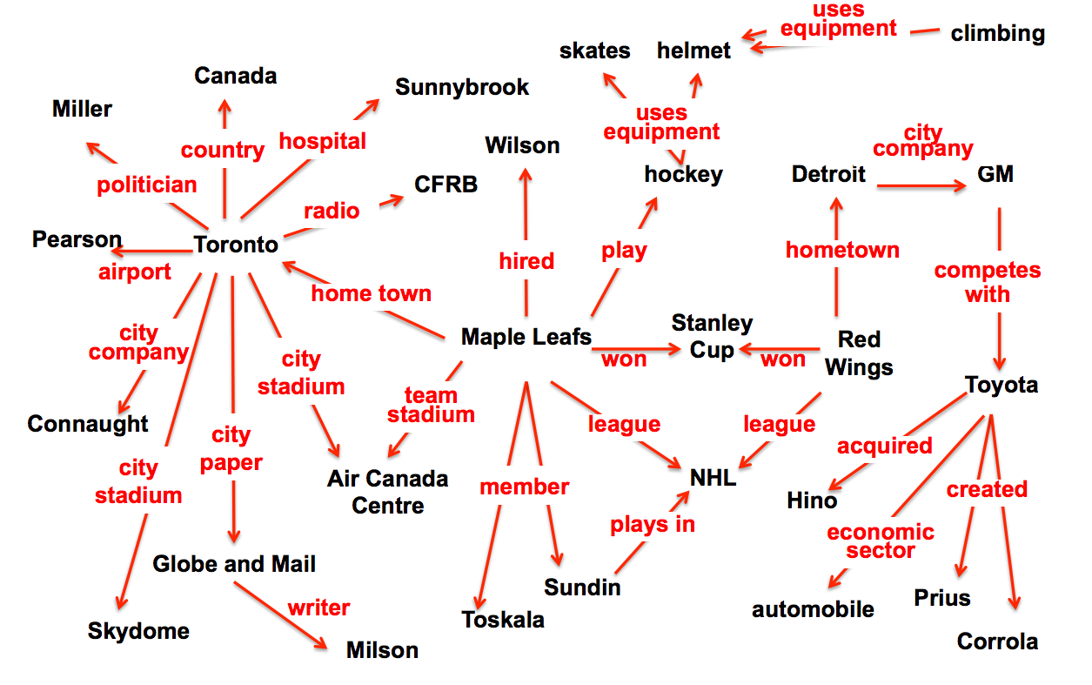
ProPPR: Infrastructure for Using Learned KBs [Wang et al, CIKM 2013,EMNLP 2014, MLJ 2015, IJCAI 2015, ACL 2015, IJCAI 2016]
Goal: learn to answer queries based on multiple redundant chains of reasoning over noisy facts and using noisy rules

Slide 5
Relational Learning Systems
MLNs
ProPPR
Task |  | Task |  | Task
2. First order program |  | Clausal 1st-order logic |  | Function-free Prolog (Datalog)
3. “Compiled” representation |  | Undirected graphical model |  | Graph with feature-vector labeled edges
Inference | Learning | approx | approx | PPR (RWR) | pSGD
formalization
easy
harder?
+DB
“compilation”
sublinear in DB size
expensive
fast
can parallelize
linear
fast, but
not convex

Slide 6
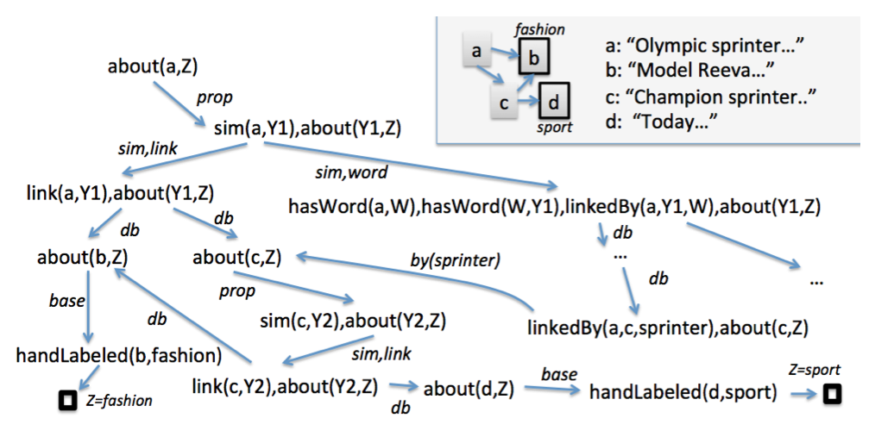
Query: about (a,Z)
DB
about(X,Z) :- hsndLabeled(X,Z) { base}
about(X,Z) :- sim(X,Y),about(Y,Z) {prop}
sim(X,Y) :- link(X,Y) {sim,link}
sim(X,Y) :-
hasWord(X,W),hasword(Y,W),
linkedBy(X,Y,W). {sim,word}
linkedBy(X,Y,W):-true {by(W)}
Program + DB + Query define a proof graph: nodes are conjunctions, and edges are labeled with sets of features.
Confidence in conclusion determined by weight count of proofs that support it
Program (label propagation)
LHS ➔ features

Slide 7
Query: about (a,Z)
DB
The proofs are counted by random walks with reset
approximately simulated using PageRank-Nibble
long proofs are unlikely

Slide 8
Query: about (a,Z)
DB
The proofs are counted by random walks with reset
approximately simulated using PageRank-Nibble
long proofs are unlikely
proofs through high fan-out nodes are unlikely

Slide 9
Query: about (a,Z)
DB
about(X,Z) :- hsndLabeled(X,Z) { base}
about(X,Z) :- sim(X,Y),about(Y,Z) {prop}
sim(X,Y) :- link(X,Y) {sim,link}
sim(X,Y) :-
hasWord(X,W),hasword(Y,W),
linkedBy(X,Y,W). {sim,word}
linkedBy(X,Y,W):-true {by(W)}
The proof graph is explored by random walks with reset
approximately simulated using PageRank-Nibble
long proofs are unlikely
proofs through high fan-out nodes are unlikely
transition probabilities are based on a weighted sum of features
weights are learned parameters
Notes:
weights are defined by program and computed on-the-fly

Slide 10
ProPPR: Infrastructure for Using Learned KBs [CIKM 2013,EMNLP 2014, MLJ 2015, IJCAI 2015, ACL 2015, IJCAI 2016]
Scales well with large KBs
Fairly expressive:
n-ary predicates
recursion
….
Can learn parameters for a “meta-interpreter” for a simpler logic ➔ structural learning
KB completion with learned rules (CIKM 2014)
Changing meta-interpreter’s templates lets you control bias
E.g., joint information-extraction and inference-rule learning (Wang & Cohen, ACL 2015)
ProPPR
Task
Function-free Prolog (Datalog)
Graph with feature-vector labeled edges
PPR (RWR) | pSGD
sublinear in DB size
fast
Also some disadvantages….
can parallelize
linear
fast, but
not convex

Slide 11
Outline
ProPPR:
Probabilistic logic system based on approximate weighted proof counting
D-Learner:
Declarative SSL system based on ProPPR
TensorLog:
New probabilistic system that compiles inference to TensorFlow computation graphs
Applications of TensorLog
Learning rules for TensorLog
Conclusions

Slide 12

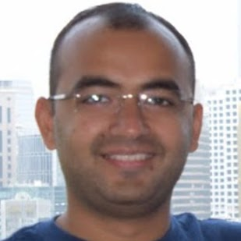
Declarative Semi-supervised Learning with ProPPR [Bing, Bhingra, Cohen, IJCAI 2017]

Slide 13
SSL problems are common
Some labeled examples, plus a larger pool of unlabeled examples.
Generally you impose some sort of smoothness assumption on classifier that holds on unlabeled examples, but there are many different heuristics for doing this
Our goal: a simple customizable solution (D-Learner)
Uniform objective function and optimization
Specifying behaviors of semi-supervised learners is simple and declarative

Slide 14
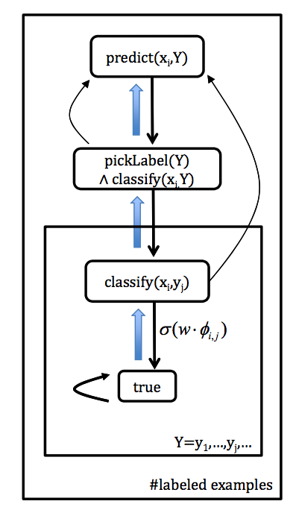
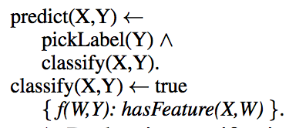
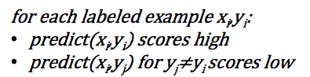
Declarative supervised learning in ProPPR
pickLabel(pos).
pickLabel(neg).
hasFeature(x1, f1_1).
hasFeature(x1,f1_2).
….
~= classify(X,Y) ← hasFeature(X,W),f(W,Y).

Slide 15
Common SSL assumption: boundary is in low-density part of the space
Alternatively:
decision boundary is far from unlabeled examples, OR
unlabeled examples are classified confidently
Examples:
Transductive SVM
Entropy regularization

Slide 16
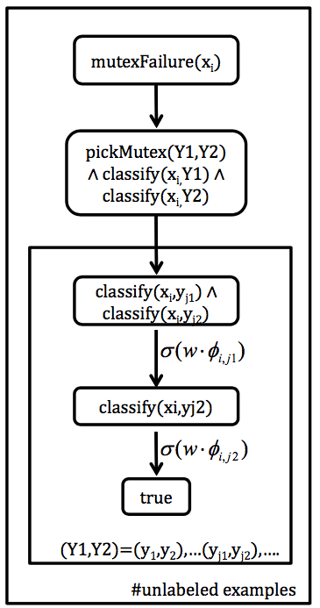
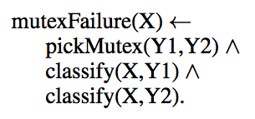
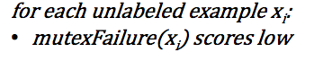
Declarative semi-supervised learning in ProPPR (1)
each example should not be classified confidently into two classes

Slide 17

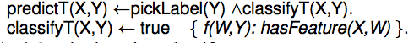
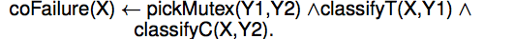
Declarative semi-supervised learning in ProPPR (2)
Consider classifying technical papers by content (word features) and citations. Define two classifiers….
Regularize them so that they agree:
For each unlabeled example x
coFailure(x) scores low

Slide 18
Declarative semi-supervised learning in ProPPR (3)
Label propagation in ProPPR: note RWR rewards many short proofs so predictions are stronger if there are many short paths to a labeled example:
lpPredict (X,Y) ← near(X,Z), label(Z,Y).
near(X,X) ← true.
near(X,Z) ← edge(X,W),near(W,Z).
We can define what “edge” means: citation graph edges, or co-citation:
edge₁(X,W) ←cites(X,W).
edge₁(X,W) ←cites(W,X).
edge₂(X,W) ←cites(X,Z),cites(Z,W).
edge₂(X,W) ←cites(Z,X),cites(W,Z).
If we want a word-based classifier, we can regularize it to agree with LP:
lpFailure(X,Y) ← pickMutex(Y,Y1), near(X,Z), predict(Z,Y1).

Slide 19
D-Learner wrap-up
Specify a learner
Specify a set of SSL heuristics in ProPPR
Let the system choose which heuristic work!
Choose weight for heuristic h_{i} by sampling an appropriate number n_{i} of the unlabeled examples
range between 0 and n_{unlabeled}
set n_{i}’s using either grid search or Bayesian optimization (Gaussian process model using Spearmint package) on dev set

Slide 20
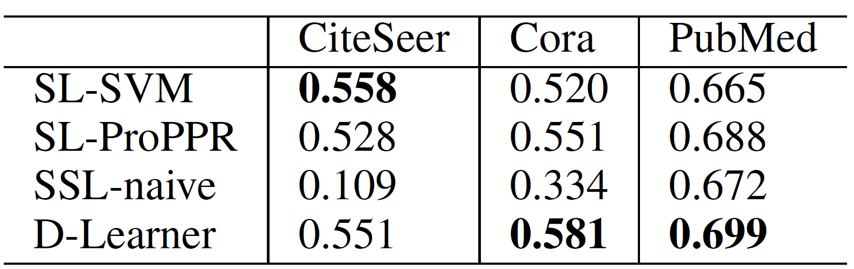
Results on link-based classification
Setting
Three datasets: CiteSeer, Cora and PubMed.
For each dataset, we use 1,000 publications for testing, and at most 5,000 publications for training. Compare to SVM, SL with ProPPR (no constraints), and SSL-naïve (all constraints with n_{i}=n_{unlabeled})
Among the training, we randomly pick 20 as labeled examples for each class, and the remaining ones are used as unlabeled.
Results

Slide 21
Real-world example: SSL for extracting medical-information relations from structured documents
Task: predict relation between a title entity e_{t} (eg in a wikipedia page) and a mentioned entity e_{m}.
SSL heuristics:
one “sense” per “discourse” #1 (all occurrances of e_{m} on a page are related the same way to e_{t} )
one “sense” per “discourse” #2 (all e_{m} ‘s in the same section are related the same way to e_{t} )
consistency between relation predictions and entity-type predictions for e_{m}

Slide 22
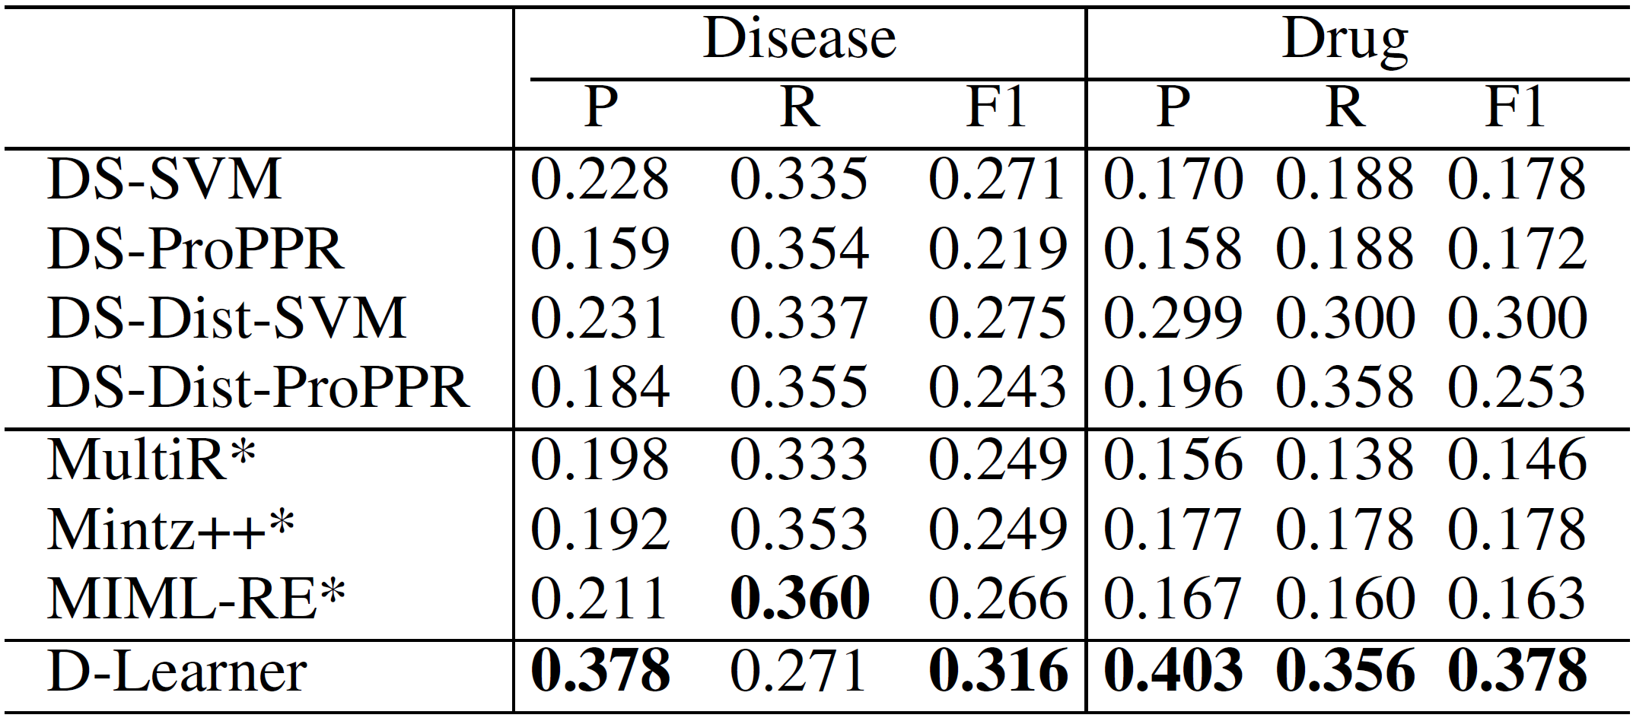
Results on relation extraction
Setting
DailyMed contains 28,590 drug articles from NLM, WikiDisease contains 8,596 disease articles from Wikipedia
Three relations for drugs, and five for diseases
Labeled examples for training from FreeBase (distant learning)
Evaluation dataset: Hand-labeled all mention entities on 10 drug pages, and 10 disease pages
Results

Slide 23
ProPPR: Infrastructure for Using Learned KBs [CIKM 2013,EMNLP 2014, MLJ 2015, IJCAI 2015, ACL 2015, IJCAI 2016]
Scales well with large KBs
Fairly expressive:
n-ary predicates
recursion
….
Can learn parameters for a “meta-interpreter” for a simpler logic ➔ structural learning
KB completion with learned rules (CIKM 2014)
Changing meta-interpreter’s templates lets you control bias
E.g., joint information-extraction and inference-rule learning (Wang & Cohen, ACL 2015)
ProPPR
Task
Function-free Prolog (Datalog)
Graph with feature-vector labeled edges
PPR (RWR) | pSGD
sublinear in DB size
fast
Only finds “easy” proofs
Groundings (graphs) are polysize but large (>10,000)
Expensive with many examples (> 10,000)
can parallelize
linear
fast, but
not convex

Slide 24
Outline
ProPPR:
Probabilistic logic system based on approximate weighted proof counting
D-Learner:
Declarative SSL system based on ProPPR
TensorLog:
New probabilistic system that compiles inference to TensorFlow computation graphs
Applications of TensorLog
Learning rules for TensorLog
Conclusions

Slide 25

D-Learner2: Based on TensorLog instead of ProPPR
Recent, unpublished work with Haitien Sun
Percent improvement over D-Learner in ProPPR with all heuristics

Slide 26
Outline
ProPPR:
Probabilistic logic system based on approximate weighted proof counting
D-Learner:
Declarative SSL system based on ProPPR
TensorLog:
New probabilistic system that compiles inference to TensorFlow computation graphs
Applications of TensorLog
Learning rules for TensorLog
Conclusions

Slide 27
Background: TensorLog

Slide 28
ProPPR vs TensorLog
ProPPR – 2013-2016
TensorLog – c. 2016
Task |  | Task
Function-free Prolog (Datalog) + features on rules |  | Function-free Prolog with weighted binary facts
Graph with feature-vector labeled edges features derived from bound vars |  | Factor graph: random variable ~ logical variables factor ~ relation/sparse matrix KB ~ tensor
PPR (RWR) | parallel SGD | Belief propagation | minibatched SGD on GPUs

Slide 29
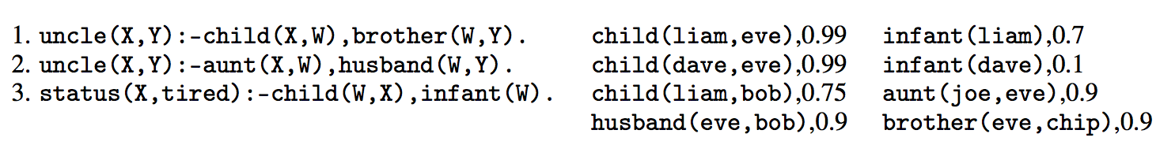

Background: PrDDB
assign_tired(tired), 1.0
Actually all constants/entities are only in the database.
Also, all numeric parameters are only in the database.

Slide 30
Background: PrDDB
Old trick: If you want to weight a rule you can introduce a rule-specific fact….
0.98
r3. status(X,tired) :- child(W,X), infant(W), weighted(r3).
weighted(r3),0.98
So learning rule weights is a special case of learning weights for selected DB facts.

Slide 31
Key question: how do you reason with neural network infrastructure?
KBANN idea (1991): convert every DB fact, and every possible inferable fact, to a neuron.
Architecture and initial weights implement inference rules

Slide 32
Key question: how do you reason?
uncle(liam,dave)
uncle(liam,eve)
uncle(liam,chip)
possible inferences
σ(….)
σ(….)
σ(….)
child(liam,eve)
brother(eve,chip)
DB facts
child(liam,bob)
“Grounding” the rules

Slide 33
Explicit grounding is not scalable
Example: inferring family relations like “uncle”
N people
N² possible “uncle” inferences
N = 2 billion ➔ N² = 4 quintillion
N = 1 million ➔ N² = 1 trillion
A KB with 1M entities is small

Slide 34
Key question: how do you reason?
KBANN idea (1991): convert every DB fact, and every possible inferable fact, to a neuron.
Similar “grounding strategies” are used by nearly every soft logic: Markov Logic Networks, Probabilistic Soft Logic, …
“Grounding” via RWR was ProPPR’s main technical innovation
A neuron for every possible inferable fact is “too many” --- i.e., bigger than the DB.

Slide 35
Key question: how do you reason?
TensorLog uses a knowledge-graph specific trick to get scalability:
“reasoning” means answering a query like: find all Y for which p(a,Y) is true for some given predicate p, query entity a (and rules and DB)
inferences for a logical theory can be encoded as a bunch of functions: for every p, f_{p}(a) returns a vector encoding answers y (and confidences)
actually we have functions for p(a,Y) and p(Y,a)….

Slide 36
Key question: how do you reason?
Example: inferring family relations like “uncle”
N people
N² possible “uncle” facts
N = 1 million ➔ N² = 1 trillion
f₁(x) = Y f₂(x) = Y
x is the nephew
x is the uncle
one-hot vectors
vectors encoding
weighted set of DB instances

Slide 37
Key question: how do you reason?
TensorLog uses a knowledge-graph specific trick…functions from sets of entities to sets of entities
Key idea: You can describe the reasoning process as a factor graph
Example: Let’s start with some example one-rule theories

Slide 38
TensorLog: Semantics 1/4
The set of proofs of a rule is encoded as a factor graph
Logical variable ➔ random variable; literal➔factor
Domain of random variable = DB entities; factors = DB relation
as sparse matrix
uncle(X,Y):-child(X,W),brother(W,Y)
X
W
brother
Y
child

Slide 39
TensorLog: Semantics 1/4
The set of proofs of a rule is encoded as a factor graph
Logical variable ➔ random variable; literal➔factor
status(X,tired):- parent(X,W),infant(W)
status(X,T):-
assign_tired(T),child(X,W),
infant(W)
uncle(X,Y):-child(X,W),brother(W,Y)
X
W
brother
Y
assign_tired
child
X
assign_r3
T
X
W
Y
child
R3
weight
aunt
husband
W
infant
uncle(X,Y):-aunt(X,W),husband(W,Y)
Key thing we can do now: weighted proof-counting

Slide 40
TensorLog: Semantics 1/4
Query: uncle(liam, Y) ?
General case for p(c,Y):
initialize the evidence variable X to a one-hot vector for c
wait for BP to converge
read off the message y that would be sent from the output variable Y.
un-normalized prob
y[d] is the weighted number of proofs supporting p(c,d) using this clause
uncle(X,Y):-child(X,W),brother(W,Y)
X
W
brother
Y
child
…
[liam=1]
[eve=0.99,bob=0.75]
[chip=0.99*0.9]
output msg for brother is sparse mat multiply: v_{W} M_{brother}
Key thing we can do now: weighted proof-counting

Slide 41
TensorLog: Semantics 1/4
For chain joins BP performs a random walk (like PRA [Lao & Cohen])
But we can handle more complex clauses as well
we assume factor graph is a polytree
status(X,T):-
const_tired(T),child(X,W),
infant(W)
uncle(X,Y):-child(X,W),brother(W,Y)
X
W
brother
Y
child
X
const_tired
T
X
W
Y
child
aunt
husband
W
infant
uncle(X,Y):-aunt(X,W),husband(W,Y)
Key thing we can do now: weighted proof-counting

Slide 42
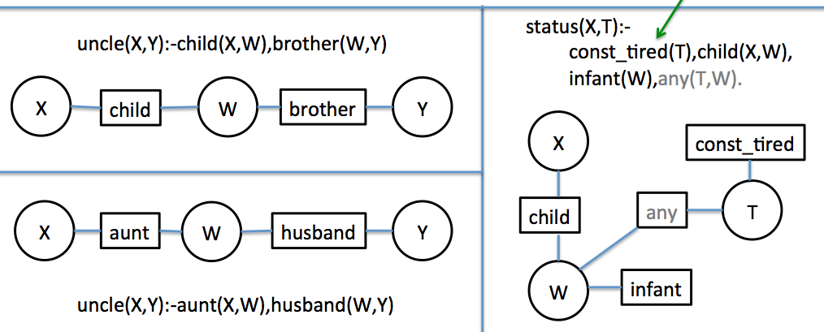
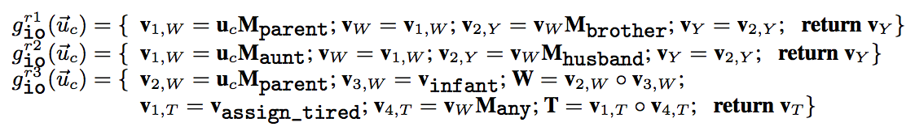
TensorLog: Semantics 2/4
Given a query type (inputs, and outputs) simulate BP on factor graph and record the series of messages that will be passed, given an input. This series of messages defines a function.
can run backprop on these
By composing and summing functions, can extend from 1-clauses to many clauses with fixed recursion

Slide 43
Key question: how do you reason?
TensorLog uses a knowledge-graph specific trick…functions from sets of entities to sets of entities
Key idea: You can describe the reasoning process as a factor graph
Example: Let’s start with some example one-rule theories
And then go on

Slide 44
TensorLog: Semantics 3/4
We can combine these functions compositionally:
multiple clauses defining the same predicate: add the outputs!
r1
g_{io}^{r1}(u) = { … return v_{Y;} }
g_{io}^{r2}(u) = { … return v_{Y;} }
r2
g_{io}^{uncle}(u) = g_{io}^{r1}(u) + g_{io}^{r2}(u)

Slide 45
TensorLog: Semantics 3/4
We can combine these functions compositionally:
defined predicate: replace the factor with a function call
r1
... = g_{aunt} (v_{W}); ….
g_{io}^{r2}(u) = { … = v_{w} M_{aunt} ; …. }
r2
Inference is via a numeric function: y’ = g_{io}^{uncle}(v), where v=u_{a} ~ {a}
y’ encodes {b:uncle(a,b)} is true and y’[b]=confidence in uncle(a,b)

Slide 46
TensorLog: Semantics 4/4
To learn and inference function for g_{io}^{uncle}
for each input v with desired output y
define a loss function
optimize to reduce loss
default loss function:
f_{io}^{uncle} (v) = softmax (g_{io}^{uncle} (v) )
loss (f_{io}^{uncle}, v, y) = crossEntropy(y, y’) where y’= f_{io}^{uncle} (v)
optimize by tuning weights on specified DB predicates (declared parameters)

Slide 47
Other Applications of TensorLog

Slide 48
Example: factual Q/A from a KB WikiMovies dataset
who acted in the movie Wise Guys? ['Harvey Keitel', 'Danny DeVito', 'Joe Piscopo', …]
what is a film written by Luke Ricci? ['How to Be a Serial Killer']
…
Data: from Miller, Fisch, Dodge, Karami, Bordes, Weston “Key-Value Memory Networks for Directly Reading Documents”
Questions: 96k train, 20k dev, 10k test Knowledge graph: 421k triples about 16k movies, 10 relations
Subgraph/question embedding:
93.5%
Key-value memory network:
93.9% “reading” the KG
76.2% by reading text of articles
starred_actors Wise Guys Harvey Keitel
starred_actors Wise Guys Danny DeVito
starred_actors Wise Guys Joe Piscopo
starred_actors Wise Guys Ray Sharkey
directed_by Wise Guys Brian De Palma
has_genre Wise Guys Comedy
release_year Wise Guys 1986
...
an initial retrieval process picks the set of
memories to start with that are relevant to
a question: KG triples or text passages

Slide 49
2k rules with 2k soft predicates
k = # relations in DB = 9
who acted in the movie Wise Guys? ['Harvey Keitel', 'Danny DeVito', 'Joe Piscopo', …]
what is a film written by Luke Ricci? ['How to Be a Serial Killer']
…
starred_actors Wise Guys Harvey Keitel
starred_actors Wise Guys Danny DeVito
starred_actors Wise Guys Joe Piscopo
starred_actors Wise Guys Ray Sharkey
directed_by Wise Guys Brian De Palma
has_genre Wise Guys Comedy
release_year Wise Guys 1986
…
written_by How to .. Killer Luke Ricci
has_genre How to .. Killer Comedy
...
answer(Question, Entity) :- mentions_entity(Question,Movie) & starred_actors(Movie,Entity) & feature(Question,F),weight1f(F)
# w1f: relation 1 going “forward”
answer(Question, Movie) :-
mentions_entity(Question,Entity) & written_by(Movie,Entity) & feature(Question,F),weight9b(F)
# w9b: relation 9 going “backward”

Slide 50
2k rules with 2k soft predicates
k = # relations in DB = 9
who acted in the movie Wise Guys? ['Harvey Keitel', 'Danny DeVito', 'Joe Piscopo', …]
what is a film written by Luke Ricci? ['How to Be a Serial Killer']
…
answer(Question, Entity) :- mentions_entity(Question,Movie) & starred_actors(Movie,Entity) & feature(Question,F),weight1f(F)
weight for rule’s inferences =
weighted count of all proofs of it =
linear combination of assigned weights for this question type to all active features

Slide 51
Example: Factual Q/A with a KB
KB contains:
KB facts from Miller et al about movies (420k)
mentions_entity(question_id, entity_id) = extract longest exact-match entity names
has_feature(question_id,word_id) = set of words in the question (after stoplisting)
Adds about 853k triples (total about 1.3M)

Slide 52
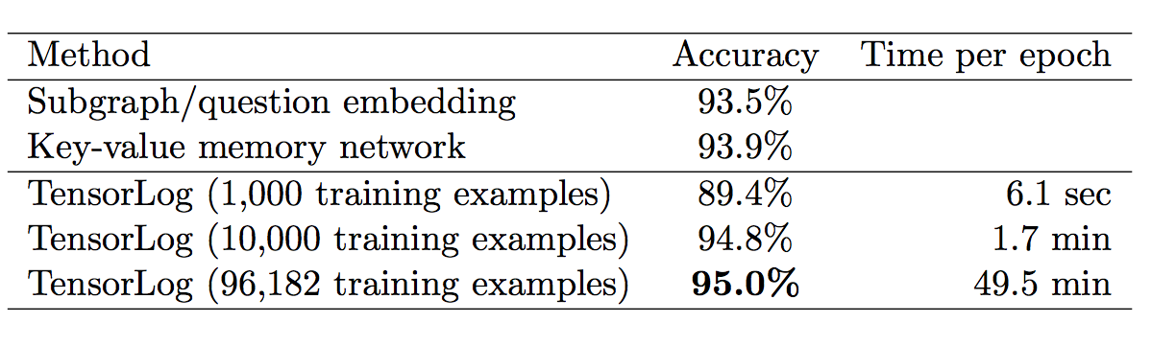
Example: Factual Q/A with a KB
Bigger differences:
memory network “works” with unstructured text instead of KB as input (with enough examples)
TensorLog allows you to update the KB declaratively

Slide 53
ProPPR vs TensorLog
ProPPR
TensorLog
Task |  | Task
Function-free Prolog (Datalog) + features on rules |  | Function-free Prolog with weighted binary facts
Graph with feature-vector labeled edges features derived from bound vars |  | Factor graph: random variable ~ logical variables factor ~ relation/sparse matrix KB ~ tensor
PPR (RWR) | parallel SGD | Belief propagation | minibatched SGD on GPUs
weight on rule features <= weighted DB facts
TensorLog is neuro-symbolic/differentiable programming system

Slide 54
ProPPR vs TensorLog
ProPPR
TensorLog
Task |  | Task
Function-free Prolog (Datalog) + features on rules |  | Function-free Prolog with weighted binary facts
Graph with feature-vector labeled edges features derived from bound vars |  | Factor graph: random variable ~ logical variables factor ~ relation/sparse matrix KB ~ tensor
PPR (RWR) | parallel SGD | Belief propagation | minibatched SGD on GPUs
extensible set of features > fixed features
weight on rule features <= weighted DB facts
n-ary predicate facts > binary predicate facts
TensorLog is neuro-symbolic/differentiable programming system

Slide 55
Comparison to ProPPR
ProPPR: downweights long, high-fanout proofs
ProPPR: locally normalized (stochastic choice of rule)
ProPPR: can create features on-the-fly during proof process
Tensorlog: weights only depend on DB facts
can sometimes manipulate them to get this bias
TensorLog: globally normalized
TensorLog: binary predicates only, weights on DB facts

Slide 56
TensorLog: Semantics vs Prior Work
TensorLog:
One random variable for each logical variable used in a proof.
Random variables are multinomials over the domain of constants.
Each literal in a proof [e.g., aunt(X,W)] is a factor.
Factor graph is linear in size of theory + depth of recursion
Message size = O(#DB constants)
Inference by differentiable function
KBANN, MLNs, most prior work
One random variable for each possible ground atomic literal [e.g. aunt(sue,bob)]
Random variables are binary (literal is true or false)
Varies: for MLN, a ground instance of a clause is a factor.
Factor graph is linear in the number of possible ground literals = O(#constants ^{arity} )
Messages are binary

Slide 57
TensorLog: Semantics vs Prior Work
TensorLog:
Use BP to count proofs
Language is constrained to messages are “small” and BP converges quickly.
Score for a fact is a potential (to be learned from data), and overlapping facts in explanations are ignored.
ProbLog2, ….probabilistic DBs
Use logical theorem proving to find all “explanations” (minimal sets of supporting facts)
This set can be exponentially large
Tuple-independence: each DB fact is independent probability ➔ scoring a set of overlapping explanations is NP-hard.

Slide 58
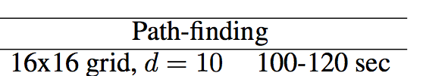
More Experiments
Inference speed vs ProbLog2 (de Raedt et al)
ProbLog2 uses the tuple-independence model
x
 |  |  | y
Each edge is a DB fact
Many proofs of path(x,y)
Proofs reuse the same DB tuples
Keeping track of all the proofs and tuple-reuse is expensive….
path(X,Y) :- edge(X,Y)
path(X,Y) :- edge(X,Z),path(Z,Y)

Slide 59
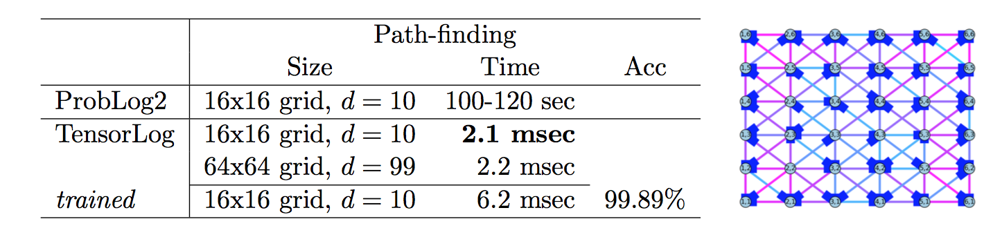
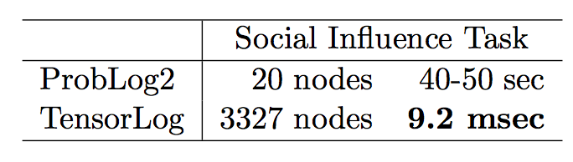
More Experiments

Slide 60
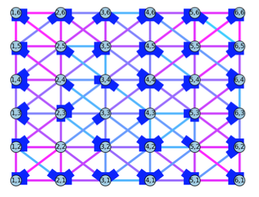
More Experiments
The semantics are different – but TensorLog can be trained to do what you want….

Slide 61
TensorLog: implementation
Compilation to Tensorflow and Theano
sparse matrices for KB relations
dense vectors for “messages” (sets of entities)
GPU-based
Python+scipy “local” implementation
sparse matrices for KB relations
sparse vectors for “messages” (sets of entities)
CPU based

Slide 62
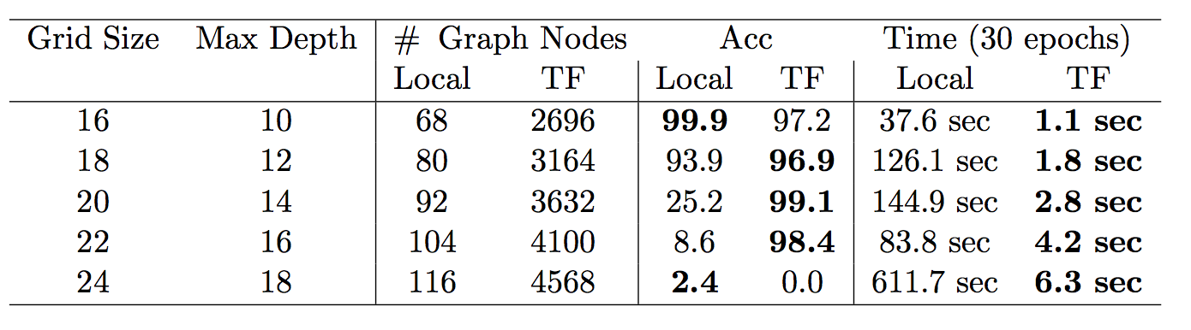
More Experiments on the Grid Task
scipy CPU and fixed gradient,
no tuning
tensorflow, GPU, Adagrad, no tuning

Slide 63
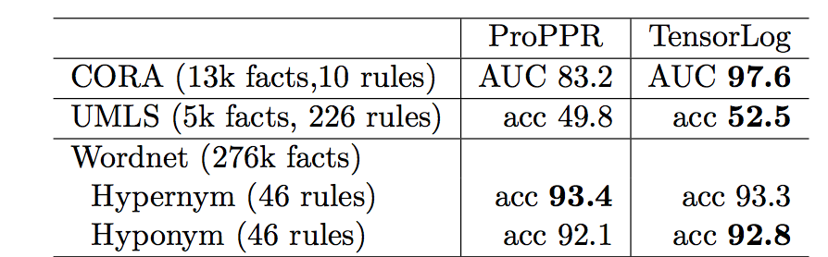
More Experiments: Relational Learning Theories Mostly from ISG (Wang & Cohen, 2014)

Slide 64
Outline
ProPPR:
Probabilistic logic system based on approximate weighted proof counting
D-Learner:
Declarative SSL system based on ProPPR
TensorLog:
New probabilistic system that compiles inference to TensorFlow computation graphs
Applications of TensorLog
Learning rules for TensorLog
Conclusions

Slide 65
Learning Rules for TensorLog
Fan Yang, Zhilin Yang, Cohen NIPS 2017

Slide 66
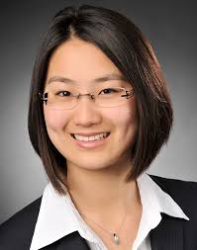
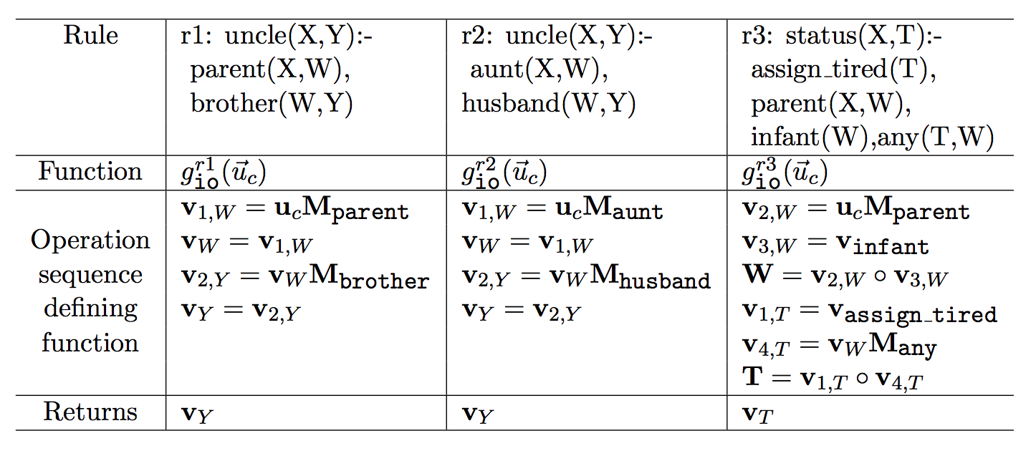
Learning rules for TensorLog
Given only examples:
uncle(liam,Y): Y should be {“bob”}
aunt(liam,Y):Y should be {“mary, “sue”}
…
Learn the inference functions
Current work with Fan Yang (2nd year PhD at CMU) and Zhilin Yang (3rd year PhD)
Basic idea:
TensorLog programs are compiled to a sequence of differentiable operators
Each operator is applied to a memory location ~= logical variable
Learn sequence with a neural controller

Slide 67
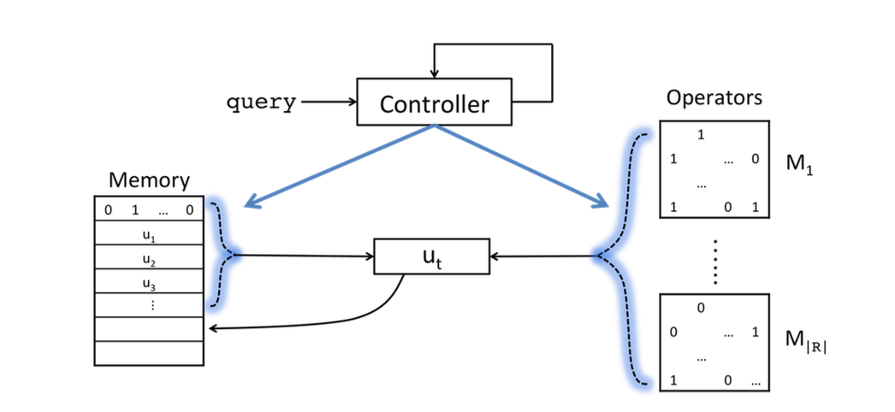
Learning rules for TensorLog
Final output is attention over memory cells after T steps
LSTM controller: reads p,a at each time step in computing Y : p(a,Y)
Current status:
chain rules only,
hard KB
New memory cell allocated at each time step: contents are formed by attention over ops and previous memory cells
Cell holds distribution over DB variables (BP message)

Slide 68
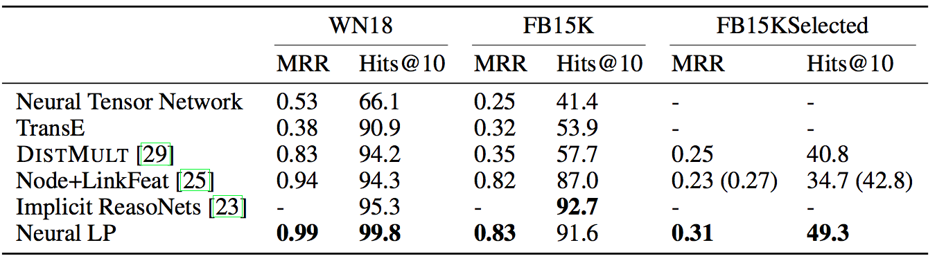
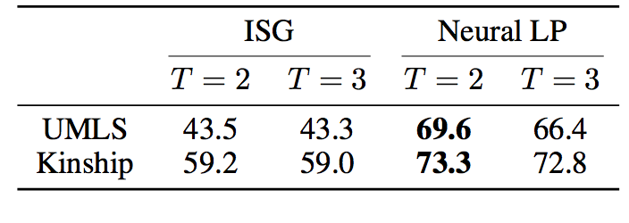
Results for Neural Inductive Logic Programming

Slide 69
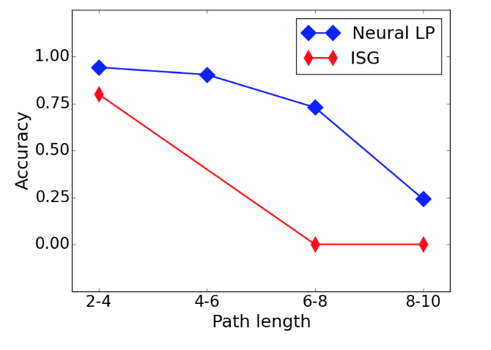
Results for Neural Inductive Logic Programming
Synthetic task: learning specific long paths in grid, like “NE-NE-S-S”

Slide 70
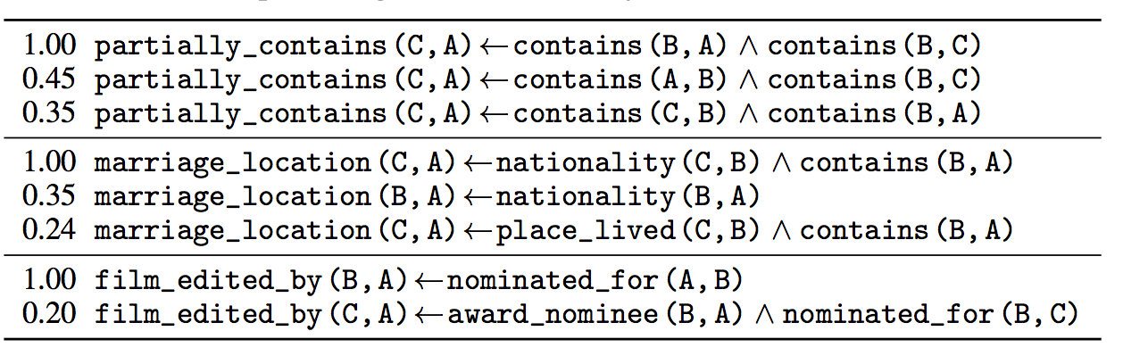
Results for Neural Inductive Logic Programming
You can reconstruct logical rules by monitoring and recording the attention on the inputs

Slide 71
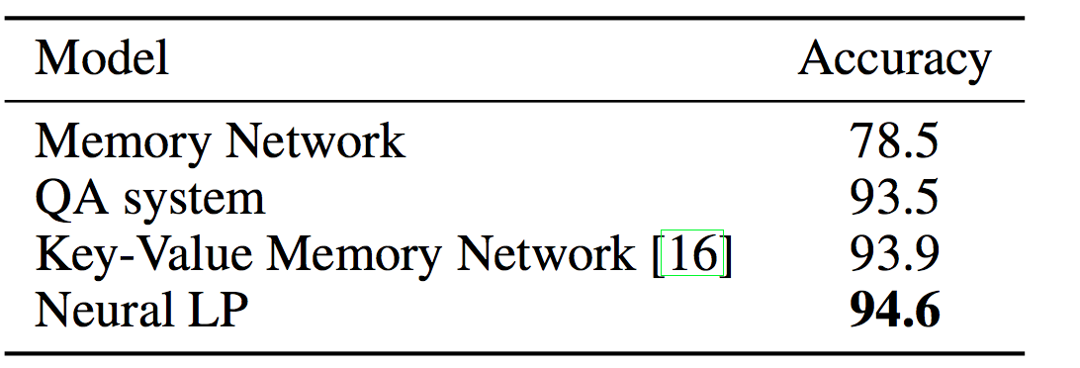
Results for Neural Inductive Logic Programming: WikiMovies
TensorLog with handcoded rules 95.0
LSTM controller: reads p,a at each time step in computing Y : p(a,Y)
LSTM controller: reads w,a at each time step in computing Y : p(w,Y), w is sum of word embeddings for words in question (100-word vocab)

Slide 72
Conclusions
As more tasks move to a neural architecture we need to understand how to integrate “old” methods (like DB) into the neural world
Declarative knowledge (facts and rules) is practically necessary
This may require substantial rethinking of prior methods
Grounding to boolean vs. compiling inference to functions

Slide 73
Conclusions
TensorLog revisits logic in a neural setting
Scalable (subject to KB fitting in memory)
Supports learning weights for KB facts and rules
Fully differentiable and easy to integrate with existing neural infrastructure
Restricted to: binary relations, polytree clauses
Still looking at
Beyond k-hot embeddings for entities and relations
Further applications/domains/tasks
Sketches
Closer integration of neural ILP and full TensorLog
Better integration with PyTorch and Theano
Integration with neural readers (e.g., Gated Attention) for better knowledge-driven NLP/semantic QA

Slide 74
Thanks to
Funders: NSF, DARPA DEFT/SAFT, Google
Questions?

